Slide 1


Hope to Skills
Lecture# 33
Irfan Malik, Dr. Sheraz Naseer

Slide 2
Agenda
Introduction to LlamaIndex
Difference between Llama-2 and LlamaIndex
Comparison of LangChain and LlamaIndex
Chatbot using LlamaIndex
Quiz

Slide 3
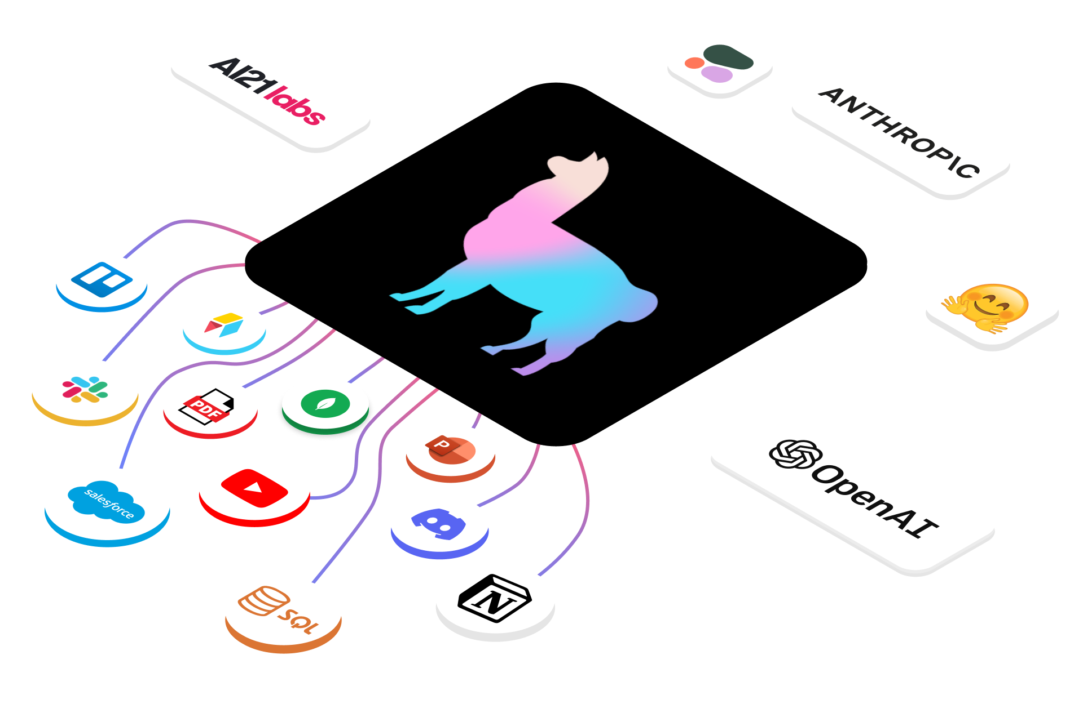
LlamaIndex?
LlamaIndex is a data framework for Large Language Models (LLMs) based applications. It enables you to ingest your own data from a variety of sources, index it in a way that is optimized for LLMs, and then query it using natural language.

Slide 4
What can you do with LlamaIndex?
LlamaIndex can be used to build a wide variety of applications, including:
Q&A over documents
Text summarization
Code generation
Creative writing
Data exploration

Slide 5
LlamaIndex vs Llama-2
Llama Index: It is a large language model index that enables efficient search and retrieval of information from a distributed corpus of text.
Llama-2: It is a large language model (LLM) that is trained on a massive dataset of text and code. Llama-2 is still under development, but it has learned to perform many kinds of tasks, including
Key differences:
LlamaIndex is a framework, while Llama-2 is a language model.
LlamaIndex is used for search and retrieval, while Llama-2 is used for generation and comprehension.

Slide 6
LlamaIndex Vs Langchain
LlamaIndex: is a lightweight tool that is specifically designed for building search and retrieval applications.
LlamaIndex is also very efficient, making it a good choice for applications that need to process large amounts of data.
LangChain: is a more general-purpose framework that can be used to build a wide variety of LLM applications.
It provides tools for loading, processing, and indexing data, as well as for interacting with LLMs. LangChain is also more flexible than LlamaIndex.

Slide 7
Feature | LlamaIndex | Langchain
Purpose | Search and retrieval | General-purpose
Interface | Simple | Flexible
Efficiency | Very efficient | Less efficient
Suitability | Applications that need to process large amounts of data | Applications that require customization

Slide 8
Ready For Coding

